Slide 1
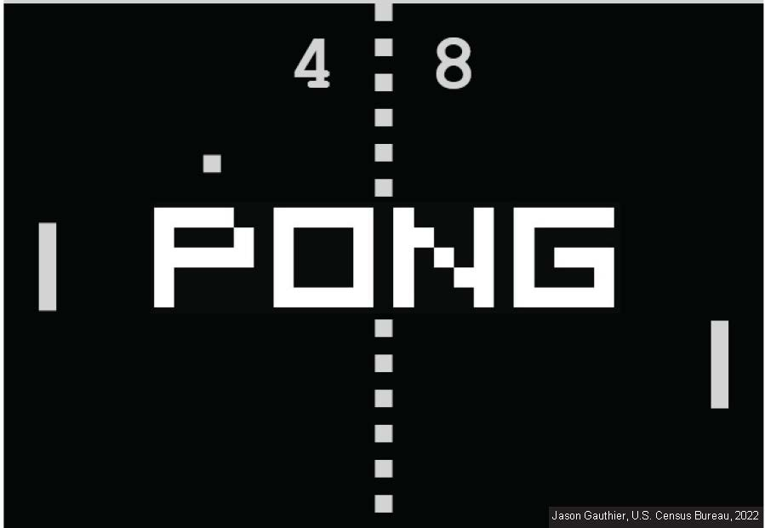
By Roy Mears, Luis Arevalo, and Jonathan Zavala

Slide 2



Pong Game Development Progress
Overview of Basic Modules & Progress
Horizontal and Vertical Sync for VGA Implementation
Testing using Test Bench Ongoing
Pixel Generation Circuit in Development for Object Display
Pong Animation

Slide 3
Key Requirements & Implementation Focus
Requirements for Pong
Clock divider
Display Resolution: 640x480
Horizontal Sync Signal
Vertical Sync Signal
Pixel Generation Circuit for Object Display
Objects: Wall, Ball, Paddle
XDC File Setup for Proper Signal Connection

Slide 4
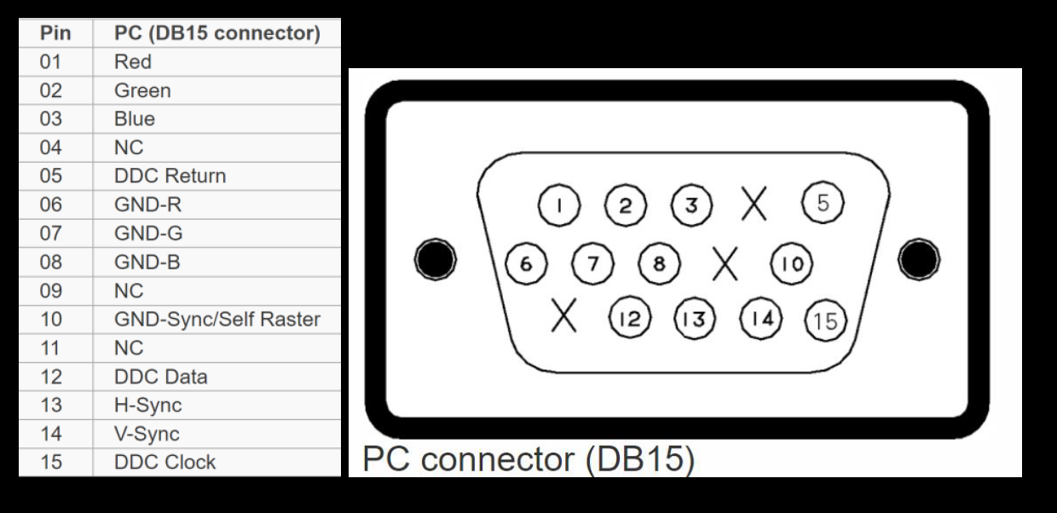
VGA Basics & Video Controller Overview
VGA Resolution: 640x480 Pixels
Color Output: Three Video Signals
Connector: 15-pin D-sub (Analog)
Video Controller Functionality:
Generates Sync Signals & Data Pixels

Slide 5
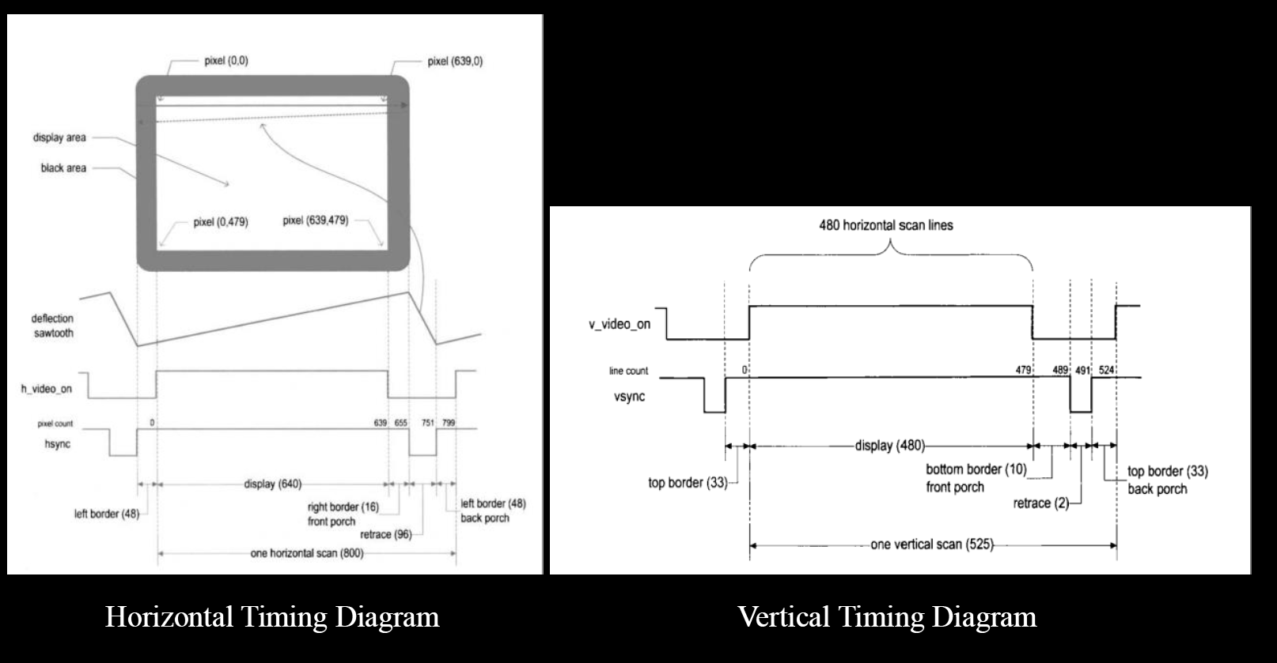
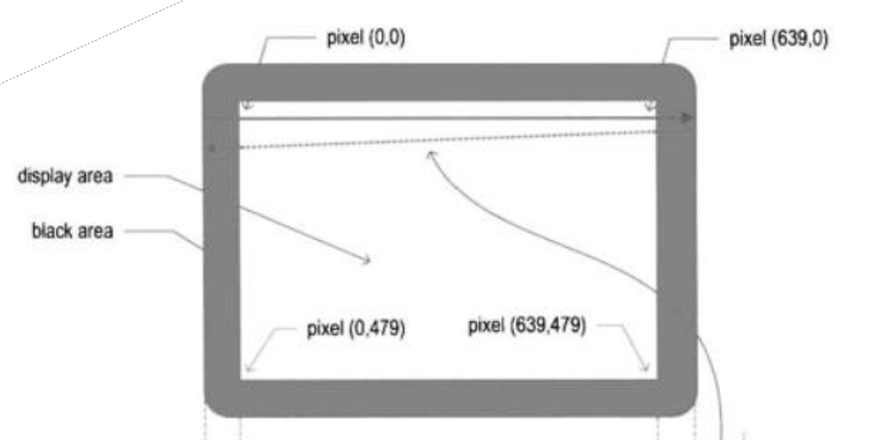
Horizontal & Vertical Sync Signal

Slide 6
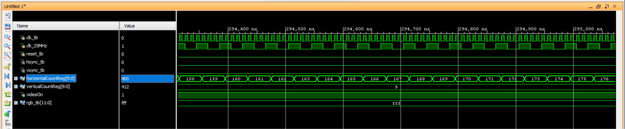
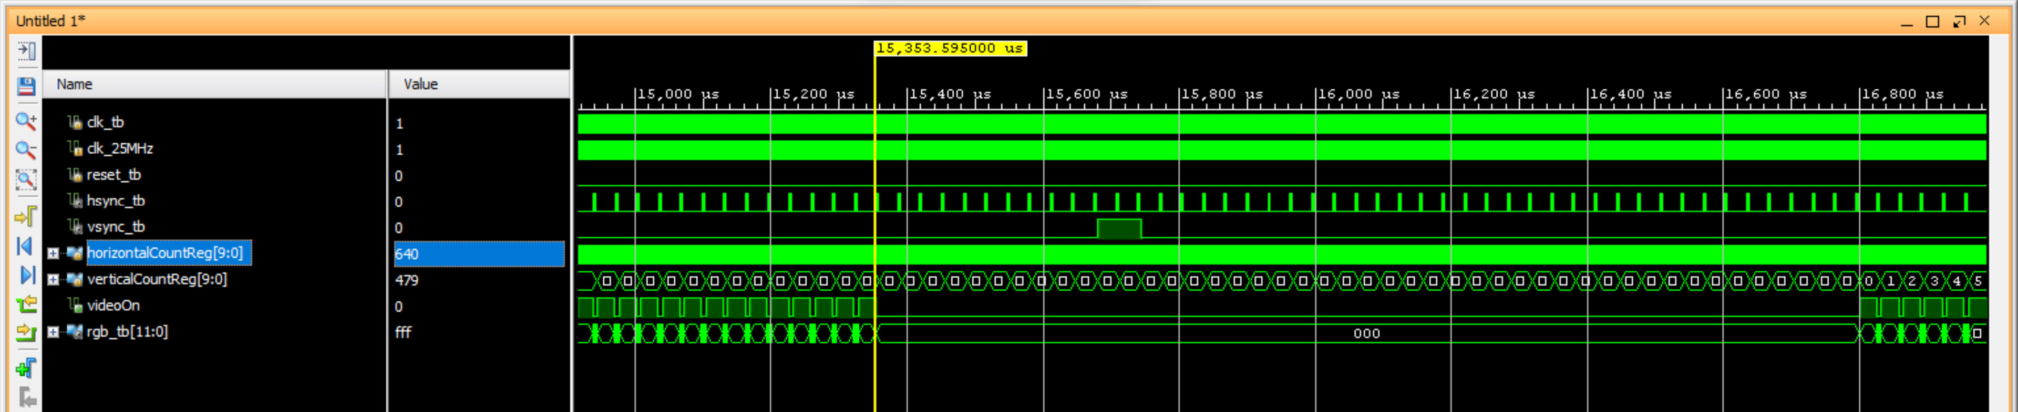
Object-Based Pixel Generation
Input Signals: video_on, pix_x, pix_y
Local Parameters for Object Boundaries
Signal Declaration for Object Regions

Slide 7
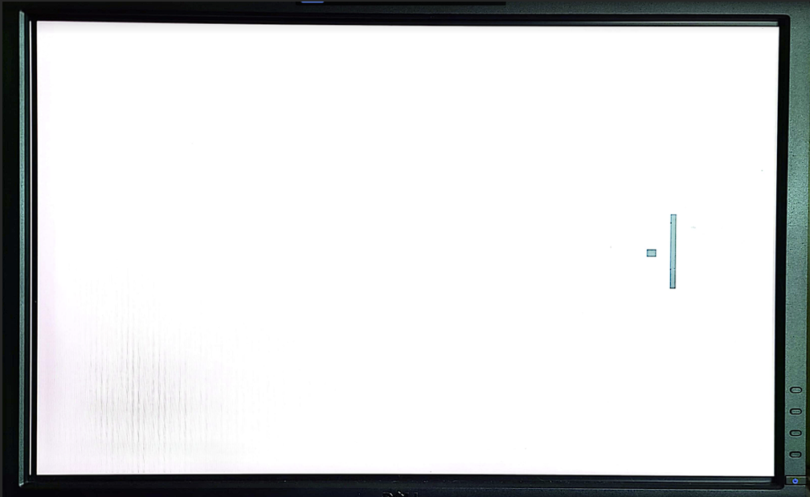
Color Assignment & Multiplexing
Signals Similar to video_on for Object Regions
Multiplexer for Color Assignment
Static Image: Black (Wall, Paddle, Ball), White (Background)

Slide 8
Pong Animation
Signals:
wall_on, ball_on
RGB Assignment:
Wall, Bar, Ball Colors Assigned
Bar's Vertical Movement:
Logic for Vertical Bar's Movement
Ball's Movement & Collision Detection:
Ball's Velocity & Direction Logic
Collision Detection with Bar & Screen Edges

Slide 9
DEMO

Slide 10
GAMEOVER
Questions?

